Slide 1
The impact of the USG Policy Protecting Life in Global Health Assistance (PLGHA) on Sida’s SRHR-HIV partnerships
Åsa Andersson, Sida

Slide 2
There is no conflict of interest to report.

Slide 3
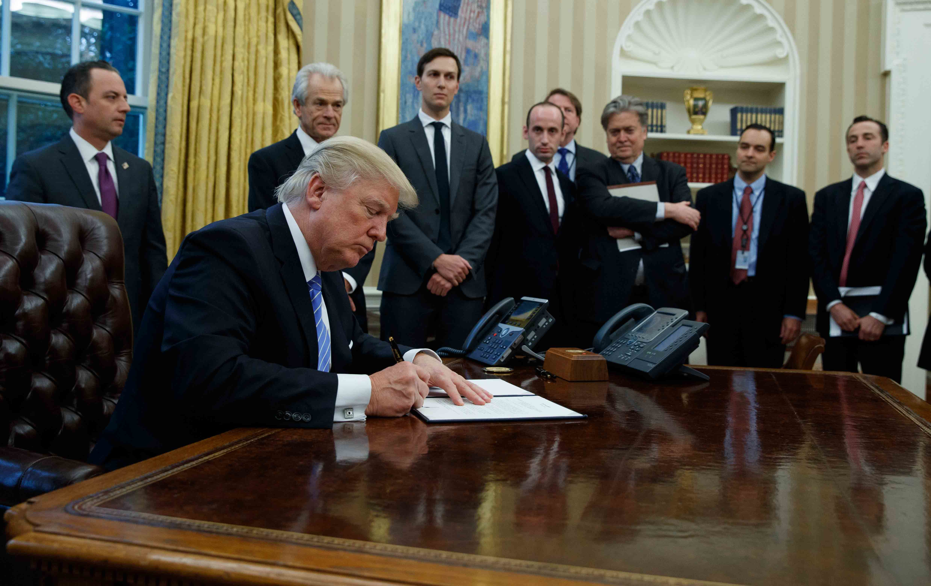
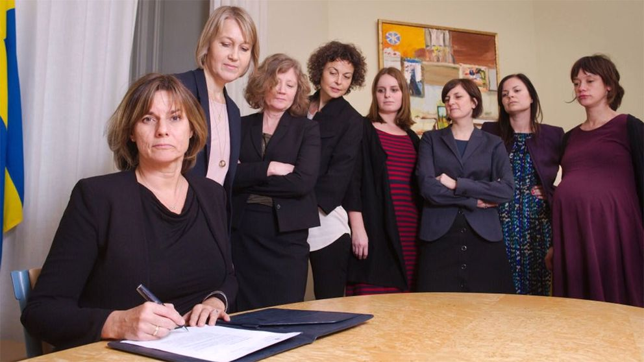
Background
Additional funds for SRHR: 22 million €

Slide 4
Sida position and guidance on MCP/PLGHA (07/07/2017)

Slide 5
Methodology
August-September 2017, portfolio assessment
30 of Sida’s NGO-partners (SRHR incl. HIV)
Set of six questions to partners, but may not be standardized across partners
Responses analysed using descriptive statistics and qualitative thematic analysis

Slide 6
Findings
1/3 had on-going US GHA agreements
2 US based NGOs indicated intent to comply with MCP/PLGHA
Six Foreign NGOs choose not to comply with MCP/PLGHA
10 sub-grantees that received US GHA were considering complying with MCP/PLGHA

Slide 7
Findings
Threat to women’s health and rights, development and Agenda 2013
Risk of discontinuation of health services
Risk of disintegration of services and fragmentation of health systems
Affecting the furthest left behind
Shrinking space for SRHR organisations and slow down normative work (chilling effect)
Organisational consequences for partners and for Sida
Notes:
Note that this is first and foremost partners’ perception of impact. Too early to see the full impact of the MCP/PLGHA policy as we did this assessment only a couple of months after the policy had been put in place.

Slide 8
Challenges
Confusion due to lack of comprehensive information on the PLGHA
Challenges with sub-grantees monitoring & reporting on PLGHA
Concern about who fills the space that a partner leaves due to no-compliance to PLGHA
Loss of funding – Sida not able to fill the gap

Slide 9
Future action
Input to the next USG review of PLGHA in Oct. 2018
Continued support to SRHR incl. HIV interventions in our bilateral, regional and global strategies
Support to studies on the impact of PLGHA
Continued engagement in the political dialogue
Global HIV Prevention Coalition,
SheDecides,
SRHR-UHC,
f/u to the MA meeting & to the ’Bold Agenda for Safe Abortion’ meeting, etc.

Slide 10
THANK YOU

